Slide 1

Revolutionizing Cricket: The IPL Ticket Booking System
The Indian Premier League (IPL) boasts a massive fan base of over 600 million viewers. Managing high ticket demand while ensuring fair access is challenging. The IPL ticket booking system addresses these challenges through innovative technology. This presentation overviews the system's key features and benefits.
BY VANSH MADAAN 500123857
ARYAN RAJ 500126035
AAYUSH SINGLA 500121157

Slide 2





Key Features of the IPL Ticket Booking System
Real-Time Availability
Secure Payment Gateway
Anti-Fraud Measures
Integrated stadium seating charts provide real-time ticket availability and seat selection.
Multiple payment methods are supported, including credit cards, UPI, and net banking.
CAPTCHA, device fingerprinting, and purchase limits prevent fraud.

Slide 3
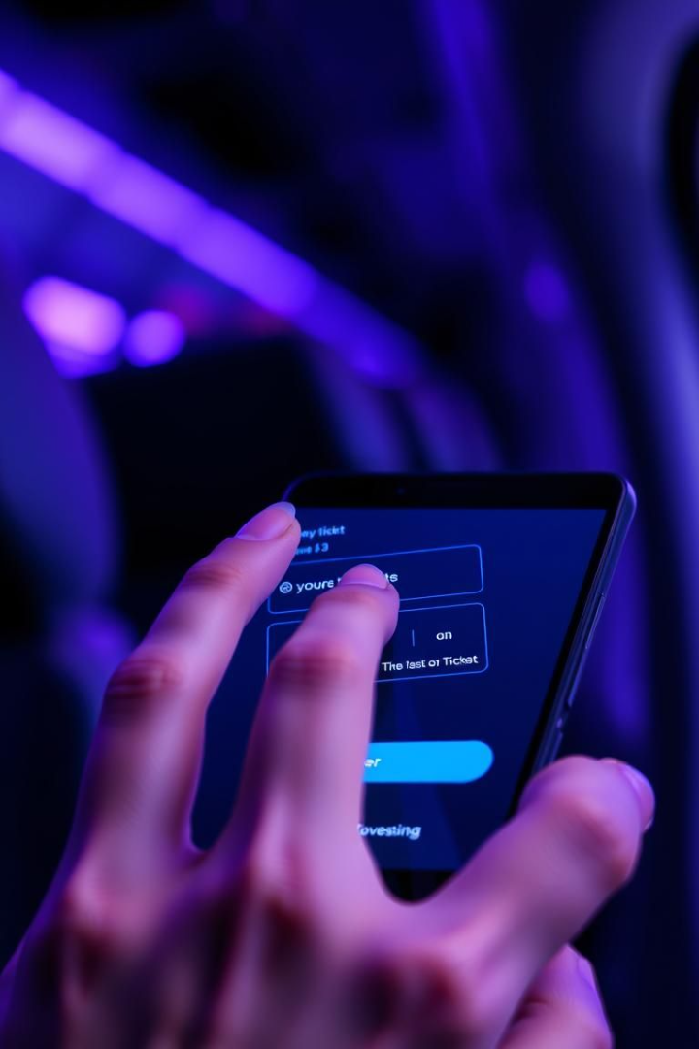




A Seamless Booking Journey
Select Match & Category
Choose the match and preferred seating category.
View & Choose Seats
See available seats in real-time and select specific seats.
Complete Payment
Pay securely through a trusted gateway.
Receive Confirmation
Get instant confirmation and e-ticket delivery.

Slide 4
Technology Behind the System
Scalable Infrastructure
Robust Database
Secure APIs
Real-time Analytics
MySQL or PostgreSQL stores ticket and user data.
Integrations with payment gateways and stadium access control.
Dashboard monitors sales, behavior, and performance.
Cloud infrastructure (AWS, Azure) handles peak traffic.

Slide 5








Security Measures: Protecting Fans
Real-time Monitoring
Purchase Limits
Bot Detection
Data Encryption

Slide 6
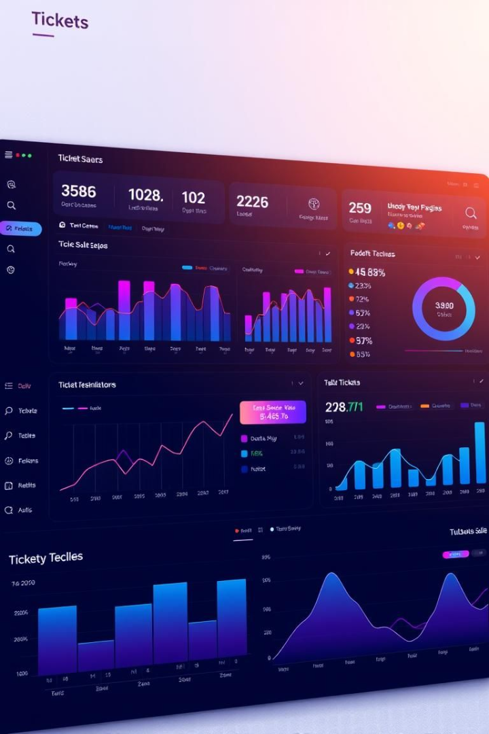



Data Analytics and Insights
Sales Trends
User Demographics
System Reports
Track ticket sales and popular matches.
Generate reports on performance and satisfaction.
Analyze user data to optimize marketing.

Slide 7

Future Enhancements
Loyalty Program Integration
Personalized Recommendations
Augmented Reality Features
Connect with fan engagement platforms.
Provide virtual stadium tours and seat previews.
Offer tickets based on user preferences.

Slide 8

Conclusion: Enhancing the IPL Experience
The IPL ticket booking system transforms how fans access and enjoy cricket. Its success comes from fair access, secure transactions, and a seamless user experience. An ongoing commitment to innovation meets the evolving needs of fans. Thank you.

Slide 9
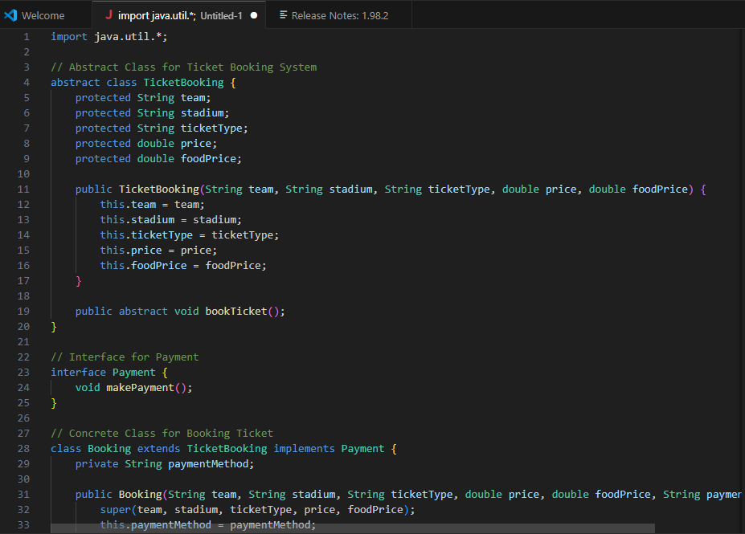

Slide 10
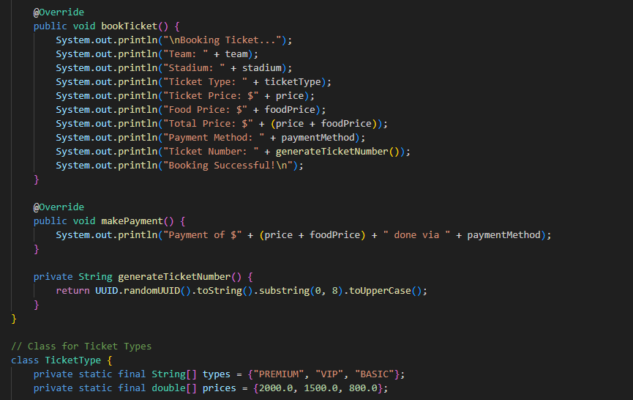

Slide 11
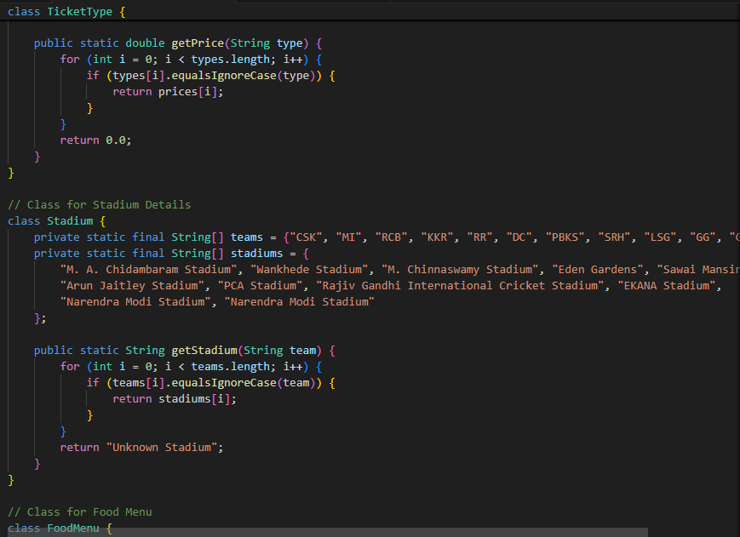

Slide 12
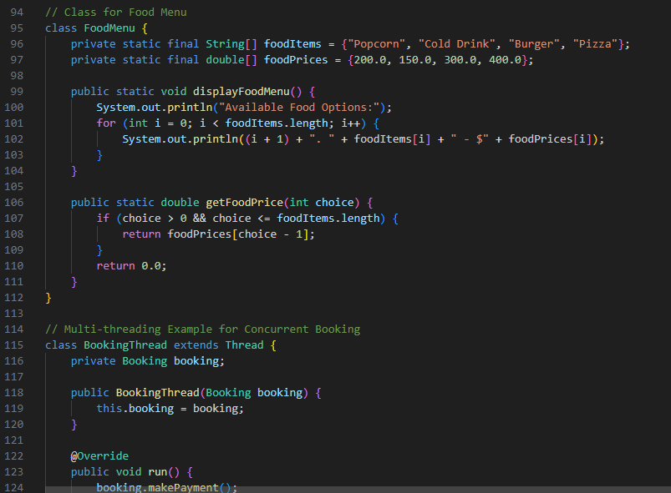

Slide 13
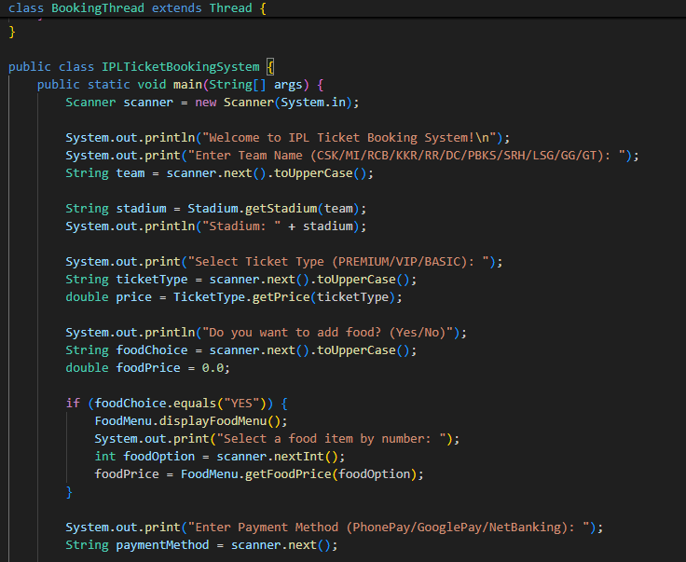

Slide 14
